Slide 1
Marketing and Speaker Toolkit
Utilize the resources in this toolkit to promote registration and your participation at this year's event. Encourage your professional network and colleagues to join us in Miami Beach, FL!

Slide 2
Introduction to the I.C.E. Exchange
We are excited to welcome you to the 2024 I.C.E. Exchange!
We created a variety of resources to help you promote your attendance and your presentation at this year’s event in Miami Beach, FL.
Browse this toolkit for sample copy you can use in email, your website, and within your social media networks.

Slide 3
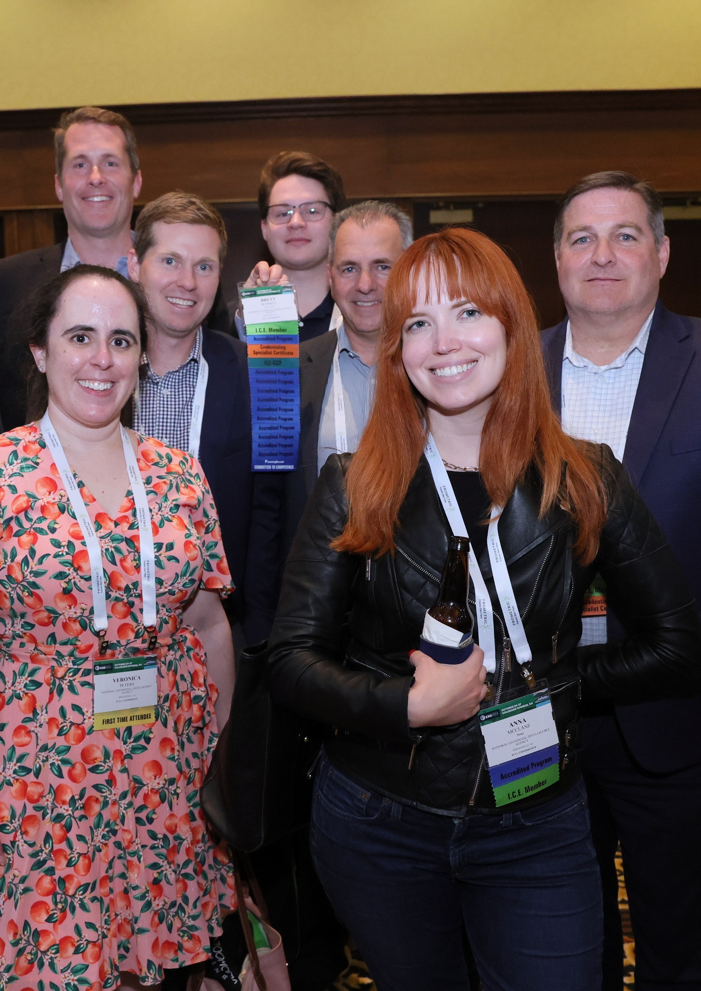
Website Content
Please use the below web content for the 2024 I.C.E. Exchange

Slide 4

Website Content
Web Banner
Add the following web banner to a high-profile page on your personal or company’s website, blog, and social media profiles.
Link the web banner to the I.C.E. Exchange website: www.ice-exchange.org

Slide 5
Website Content
Post the below event listing to your company’s website or calendar of events page. If you can’t use all of the copy below, just use the event name, date, location, and URL.
  I.C.E. Exchange 2024
  November 17 – 20 | Miami Beach, Florida
  www.ice-exchange.org
  Join credentialing professionals at the I.C.E. Exchange 2024 in Miami Beach, Florida, November 17 – 20. This premier annual conference brings together credentialing professionals from across industries and career stages to explore credentialing trends, share best practices, and foster valuable connections. Featuring keynote presentations, interactive workshops, and networking opportunities, the I.C.E. Exchange is the ideal platform to advance your knowledge and enhance your credentialing programs. Visit the I.C.E. website to view all programming and register for the event. We look forward to seeing you in Miami Beach!
For a more customized message, use the below listing:
  [Name] will be presenting at the I.C.E. Exchange 2024, hosted in Miami Beach, Florida, November 17 – 20. As an expert in [topic], [he/she/they] will be presenting “[title]” on [date/time]. Register today to attend this presentation! We look forward to seeing you in Miami Beach.

Slide 6
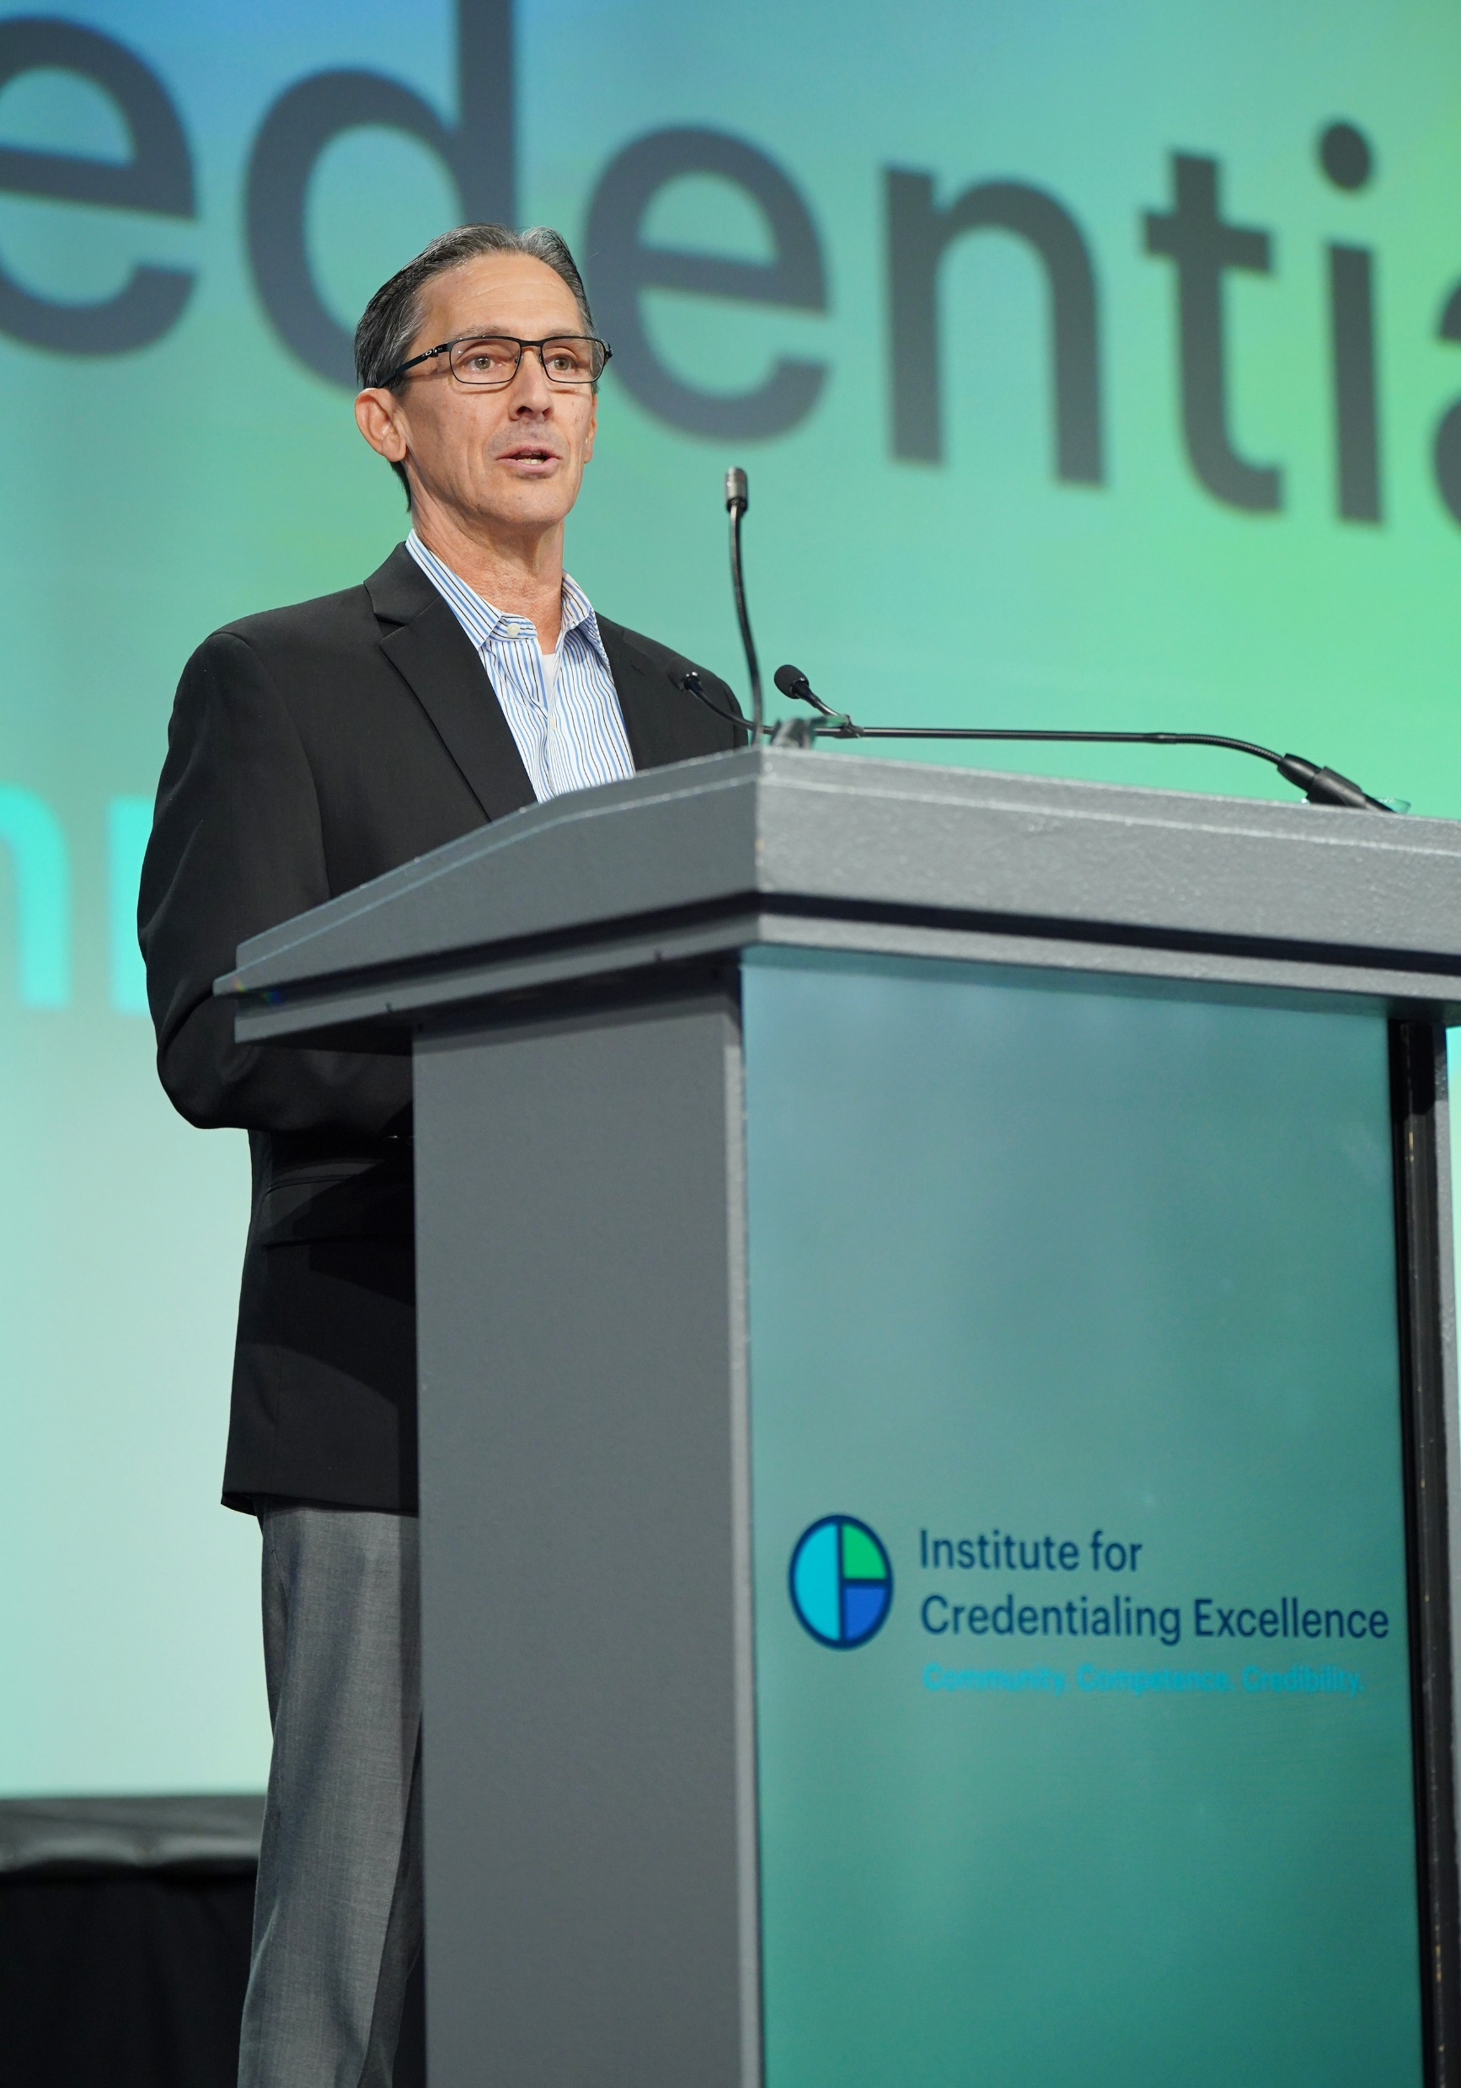
Promotional Email
Share email messages to encourage your network to attend the I.C.E. Exchange and your session.

Slide 7
Sample Email
Subject: Join Me at the I.C.E. Exchange to Learn More About [Topic]!
Body: Dear [Name],
Join me at the I.C.E. Exchange hosted by the Institute for Credentialing Excellence (I.C.E.) November 17-20, 2024 in Miami Beach, FL. This premier event for credentialing professionals offers unparalleled education, networking, and resources. In addition to my session, you'll engage with peers, participate in interactive sessions, and explore trends such as AI advancements, remote proctoring, test security, and program development—all designed to enhance credentialing processes and elevate program success.
I am excited to share my expertise in [Topic] during my session titled “[Session Title].” In this session, you will gain insights into [Learning Objective 1], [Learning Objective 2], and [Learning Objective 3].
Visit the I.C.E Exchange website to register and learn more. I look forward to seeing you at Miami Beach, FL.
Sincerely, [Signature]

Slide 8
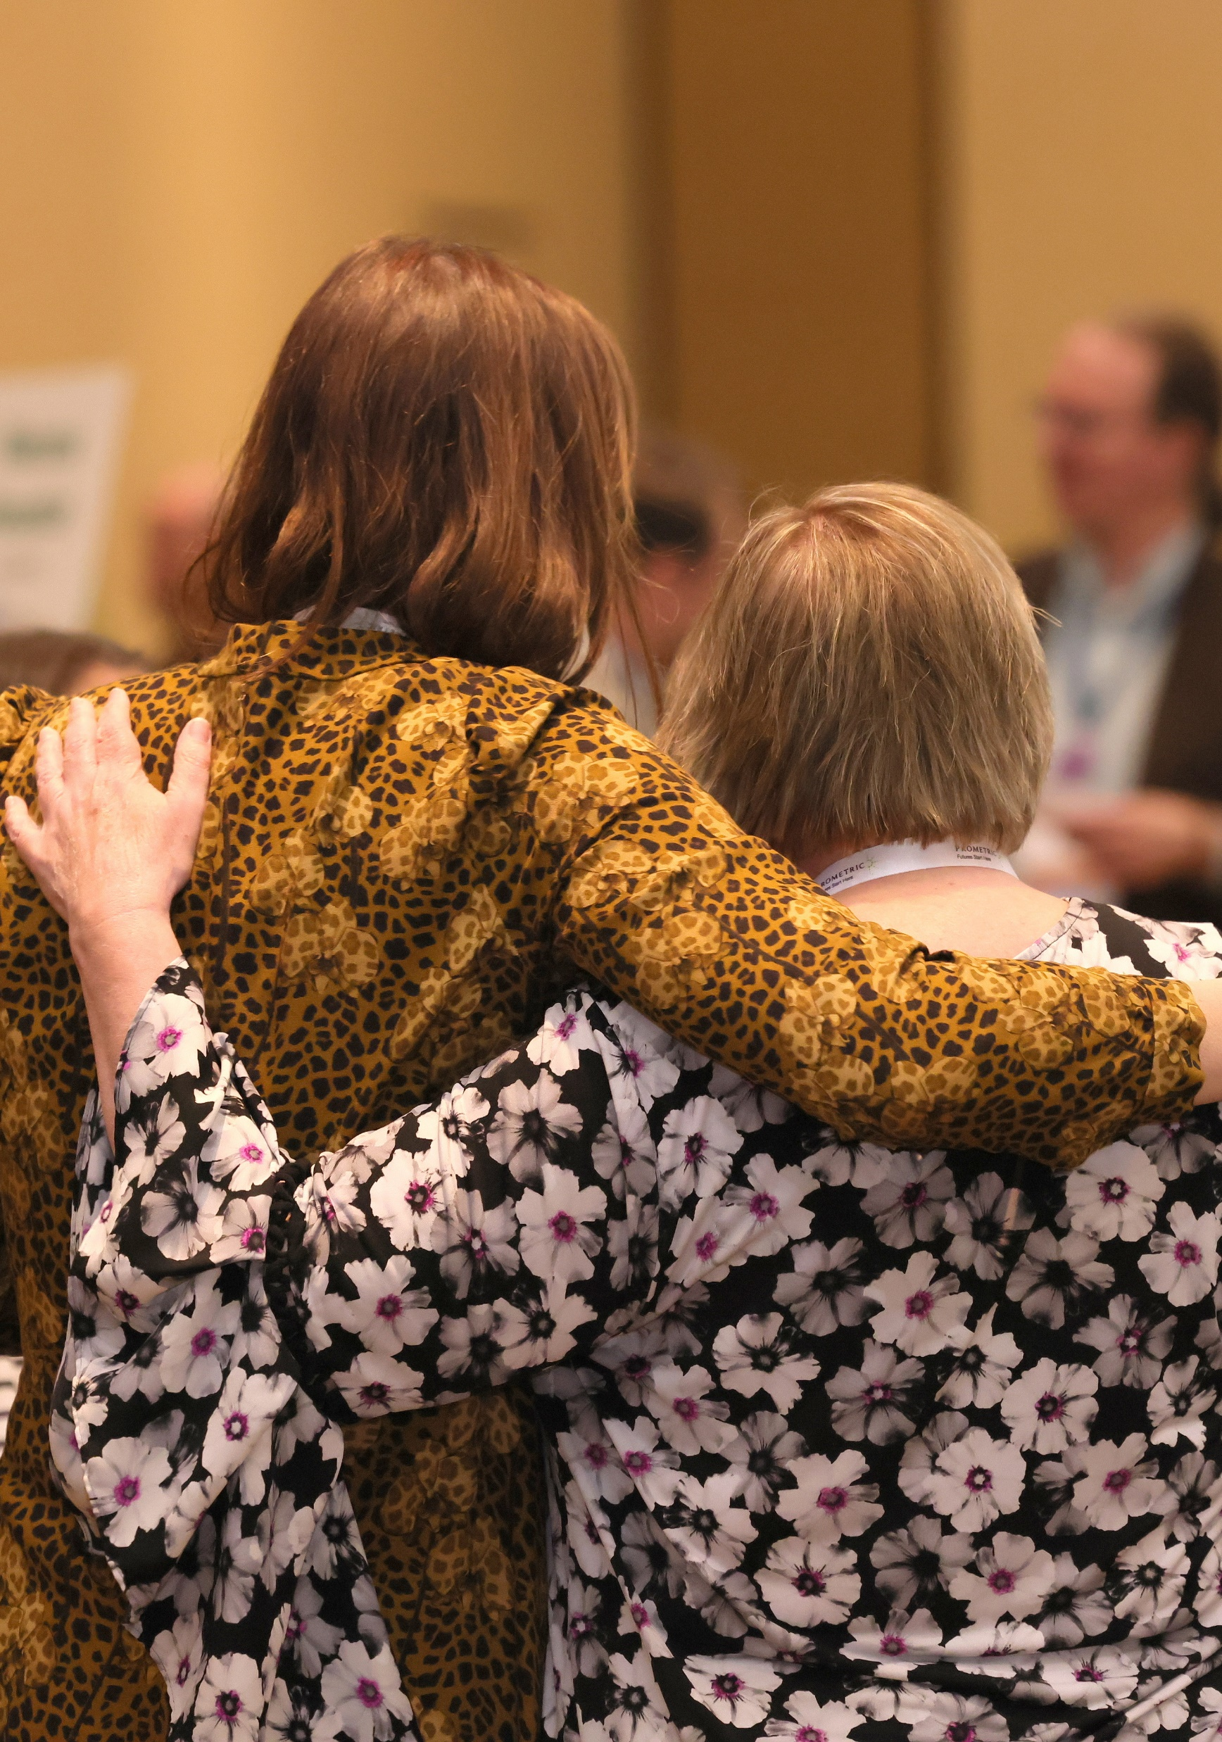
Social Media
Use social media to help us promote the 2024 I.C.E. Exchange on your personal social media channels.
Use #EXG2024 and tag us on LinkedIn so we can interact with your posts!

Slide 9
Sample Social Media Posts
Register now to join me at #EXG2024, where I’ll be presenting about [Topic]. I’m excited to collaborate on [Date]! Secure your spot: https://www.ice-exchange.org/Registration
Did you hear? I’m presenting about [Topic] at #EXG2024 this November! Register before the early bird deadline, October 4 and join me at my session on [Date] to learn more about [Topic]! https://www.ice-exchange.org/Registration
The countdown is on for #EXG2024! Mark your calendar for my presentation on [Date] about [Topic]. I look forward to connecting with you in Miami Beach! https://www.ice-exchange.org/Registration
  Utilize these social media posts to increase excitement around the Exchange.
  Don't forget to include an image and use the event hashtag #EXG2024.

Slide 10


Social Media Graphics
LinkedIn Graphic
LinkedIn Header

Slide 11
Social Media Dos & Don'ts
In LinkedIn's professional setting, concise posts are more effective, emphasizing clarity and brevity.
Tag I.C.E. for enhanced engagement. @Institute for Credentialing Excellence in your posts to broaden visibility.
Incorporate hashtags such as #EXG2024 to connect with professionals interested in the event.
Post during peak LinkedIn activity hours, typically mid-morning (around 9 AM to 11 AM) and early afternoon (1 PM to 3 PM), to maximize visibility and engagement.
Share registration links to I.C.E. events or resources to effectively guide interested audiences: https://www.ice-exchange.org/Registration

Slide 12
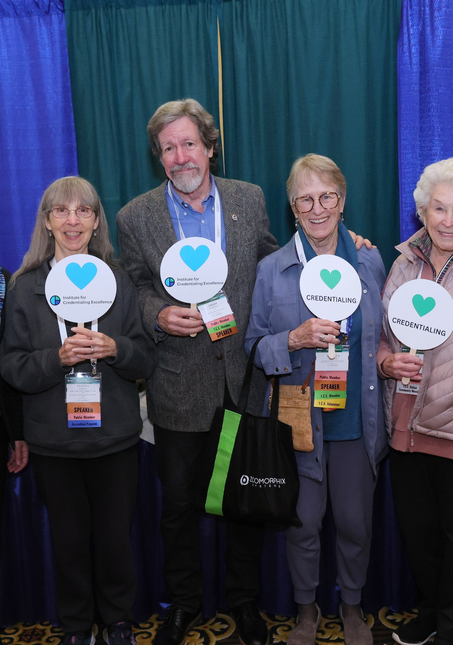
Record a Promotional Video
Spread the word about your session in a video message.

Slide 13
Share a Video
Record a video encouraging people to attend your session.
Click the link below to share a brief video message about your session. Your video will be automatically sent to I.C.E. for promotional use!
In 140 seconds or less, introduce yourself, outline your session topic, and explain why attendees should attend your session.
Record Your Video Message Here

